Slide 1
Logistic Regression and Generalized Linear Models

Slide 2
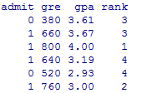
Data Objects: Logistic Regression
Dataset
mydata <- read.csv(url("http://www.ats.ucla.edu/stat/data/binary.csv"))
Description of the data Set
This dataset has a binary response (outcome, dependent) variable called admit.
There are three predictor variables: gre, gpa and rank.
Variables gre and gpa are continuous.
The variable rank takes on the values 1 through 4.
Institutions with a rank of 1 have the highest prestige, while those with a rank of 4 have the lowest.
The response variable, admit/don't admit, is a binary variable.

Slide 3
Questions
How do variables, such as GRE (Graduate Record Exam scores), GPA(grade point average) and prestige of the undergraduate institution, effect admission into graduate school.
How does a one unit increase in gpa change the odds (Odds ratio) of being admitted to graduate school (versus not being admitted)?
Predict the probability of admission at each value of rank, keeping gre and gpa at their means.
Create a table of predicted probabilities by varying the value of gre.
What does the model fit test (significance of the overall model) indicate?

Slide 4
Introduction to Logistic Regression
What is Logistic Regression
Logistic Regression on (or logit model) is a statistical model used for prediction of the probability of occurrence of an event.
Most problems of logistic regression involves classifying a new observation into to one of the many possible classes based on the value of its explanatory variable.
Binomial Logistic Regression
Binomial (or binary) logistic regression is a model in which the dependent variable is dichotomous.
The independent variables may be of any type.

Slide 5
Introduction to Logistic Regression (cont.)
More robust than linear Regression
Error terms need not be normal
No requirement for equal variance for error term
No requirement for linear relationship between dependent and independent variables
Logistic regression is perfect for situations where you are trying to predict whether something "happens" or not
A chi-square test is used to indicate how well the logistic regression model fits the data
Business Problems in Marketing/Retail
What is the success probability of a new product?
What is the impact of food label on purchase decision?

Slide 6
Introduction to Logistic Regression (cont.)
Which promotion is more effective?
Which channel of delivery is more effective?
What is the credit risk associated with retail store?
Business Problems in Banking & Finance
What is the risk associated with a customer?
Which customer is likely to default?
What percentage of loans is likely to result in a loss?
How to identify the most profitable customer?

Slide 7
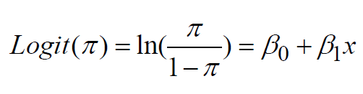
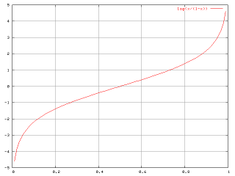
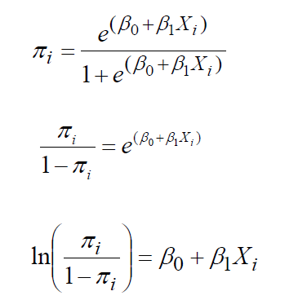
Introduction to Logistic Regression (cont.)
The logit function is the logarithmic transformation of the logistic function.
Logistic Transformation

Slide 8
Case Study
> summary(gre)
Min. 1st Qu. Median Mean 3rd Qu. Max.
220.0 520.0 580.0 587.7 660.0 800.0
>sd(gre)
[1] 115.5165
> summary(gpa)
Min. 1st Qu. Median Mean 3rd Qu. Max.
2.260 3.130 3.395 3.390 3.670 4.000
> sd(gpa)
[1] 0.3805668
> table(rank)
rank
1 2 3 4
61 151 121 67

Slide 9
Case Study (cont.)
> table(admit)
Admit
0 1
273 127
> table(rank,admit)
Admit
rank 0 1
1 28 33
2 97 54
3 93 28
4 55 12
Using the logit model
> mylogit<- glm(admit~gre+gpa+as.factor(rank), mydata, family=binomial(link="logit"), na.action=na.pass)

Slide 10
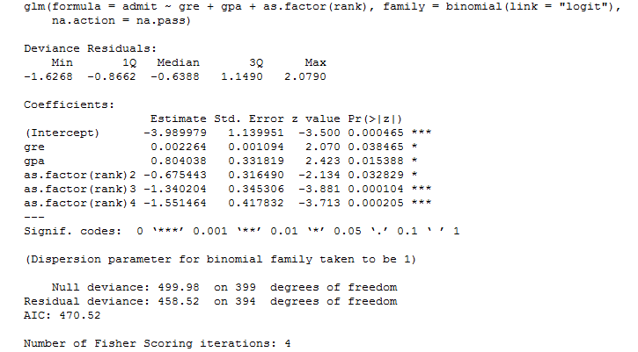
Case Study (cont.)
>summary(mylogit)
TIPS: Model fine-tuning is the road to success….

Slide 11
Case Study (cont.)
Interpretation
Both gre and gpa are statistically significant, as are the three terms for rank.
The logistic regression coefficients give the change in the log odds of the outcome for a one unit increase in the predictor variable.
For every one unit change in gre, the log odds of admission (versus non-admission) increases by 0.002.
For a one unit increase in gpa, the log odds of being admitted to graduate school increases by 0.804.
The indicator variables for rank have a slightly different interpretation. For example, having attended an undergraduate institution with rank of 2, versus an institution with a rank of 1, decreases the log odds of admission by 0.675

Slide 12
Case Study (cont.)
We can use the confit(...) function to obtain confidence intervals for the coefficient estimates.
> confint(mylogit)
2.5 % 97.5 %
(Intercept) -6.2716202334 -1.792547080
gre 0.0001375921 0.004435874
gpa 0.1602959439 1.464142727
as.factor(rank)2 -1.3008888002 -0.056745722
as.factor(rank)3 -2.0276713127 -0.670372346
as.factor(rank)4 -2.4000265384 -0.753542605

Slide 13
Case Study (cont.)
Odds Ratio
You can exponentiate the coefficients and interpret them as odds- ratios.
exp(mylogit$coefficients)
(Intercept) gre gpa as.factor(rank)2
0.0185001 1.0022670 2.2345448 0.5089310
as.factor(rank)3 as.factor(rank)4
0.2617923 0.2119375
A one unit increase in gpa, the odds of being admitted to graduate school (versus not being admitted) increase by a factor of 2.23

Slide 14

Case Study (cont.)
Predicted probability of admission at each value of rank, holding gre and gpa at their means
rank <- c(1,2,3,4)
gre <- c(mean(mydata$gre))
gpa <- c(mean(mydata$gpa))
newdata1 <- data.frame(gre,gpa,rank)
newdata1$rankP <-predict(mylogit,newdata=newdata1,type="response")
>newdata1
The predicted probability of being accepted into a graduate program is 0.52 for students from the highest prestige undergraduate institutions (rank=1), and 0.18 for students from the lowest ranked institutions (rank=4), holding gre and gpa at their means.

Slide 15
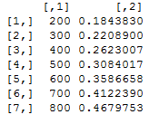
Case Study (cont.)
Create a table of predicted probabilities varying the value of gre.
newdata2<data.frame(gre=seq(200,800,100),gpa=mean(mydata$gpa),rank=2)
newdata2$greP<predict(mylogit,newdata=newdata2,type="response")
cbind(newdata2$gre,newdata2$greP)

Slide 16
Case Study (cont.)
Find the difference in deviance for the two models:
> with(mylogit, null.deviance - deviance) 41.46
The degrees of freedom for the difference between the two models is equal to the number of predictor variables in the mode, and can be obtained using:
> with(mylogit, df.null - df.residual) 5
The p-value can be obtained using:
> with(mylogit, pchisq(null.deviance - deviance, df.null - df.residual, lower.tail = FALSE)) 7.578e-08
The chi-square of 41.46 with 5 degrees of freedom and an associated p-value of less than 0.001 tells us that our model as a whole fits significantly better than an empty model.

